Slide 1

Program of Studies Meeting: Research Intro
Ricardo Jacome
Midwest Roadside Safety Facility
University of Nebraska-Lincoln
03/13/2020

Slide 2
Research Overview
On Road Coordinate Decomposition for Autonomous Vehicle (AV) Guidance
Main Motivation:
AV systems depend entirely on sensors for navigation
There is a need to find alternative solutions for this problem
General Objective:
Provide a road profile for AVs to navigate on a road, independent of vehicle sensors

Slide 3
Previous Work
Phase I: Literature Review + ABS Testing
Investigation on current AV technology
Evaluation of ABS performance testing
Emergency capacity of a vehicle
Phase II: Road Profile Generation Framework
How to formulate road profiles
How to implement with current infrastructure

Slide 4
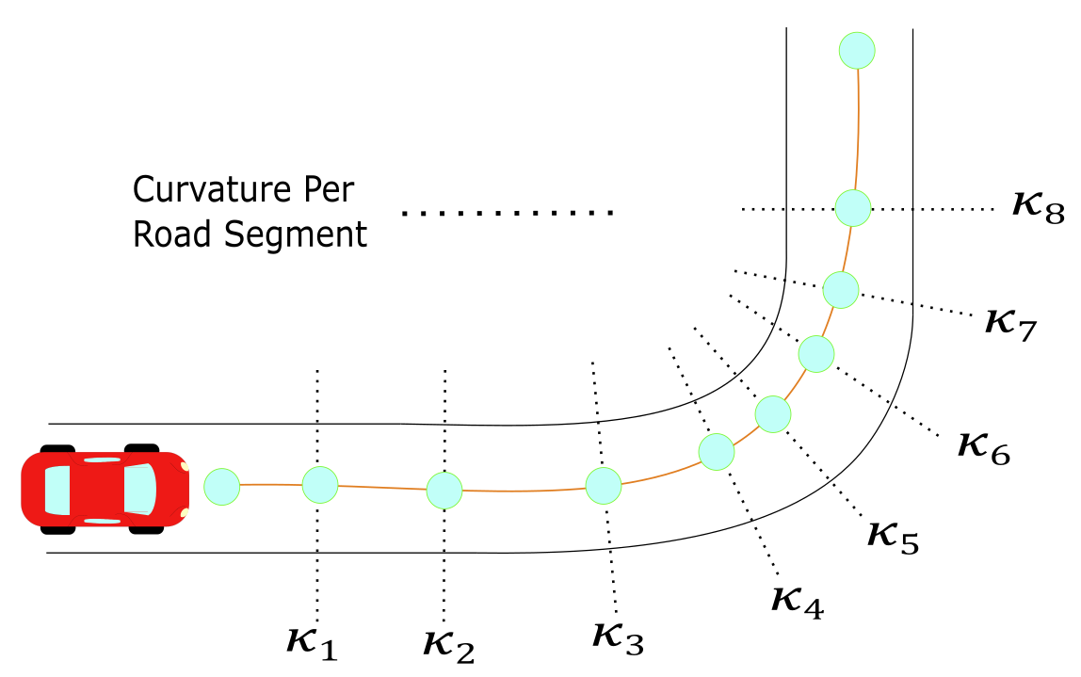
Create a Figure of the same, with arrows.

Slide 5
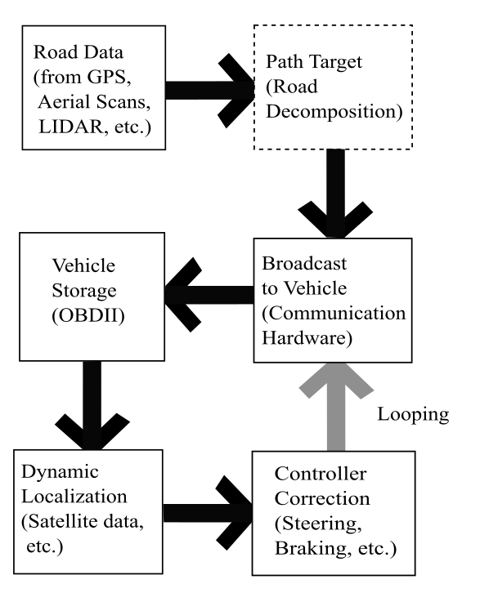
Road Profile with Infrastructure

Slide 6
Previous Work Documents
MATC Year 1 Report
MATC Year 2 Report
SAE Publication

Slide 7
Current Work
ABS Acceleration Data, New Filtering Method Developed (Should I??????)
Optimization Method for Road Profile
Selection of the best trajectory dependent on certain parameters
Current Velocity, Vehicle dimensions, Street Guidelines.

Slide 8
Future Work
A complete method to generate road profiles from different data sources (such as satellite scans).

